Slide 1

Lay Off 2023
Group 2 – Termeh Mohebbie, Gilaine Soares, David Wang, Md Moshin Rana

Slide 2
Project Overview
Topic Overview
Data Manipulation
Coding process
Findings

Slide 3
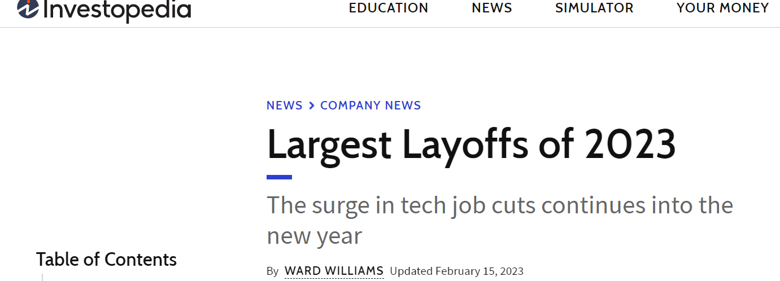
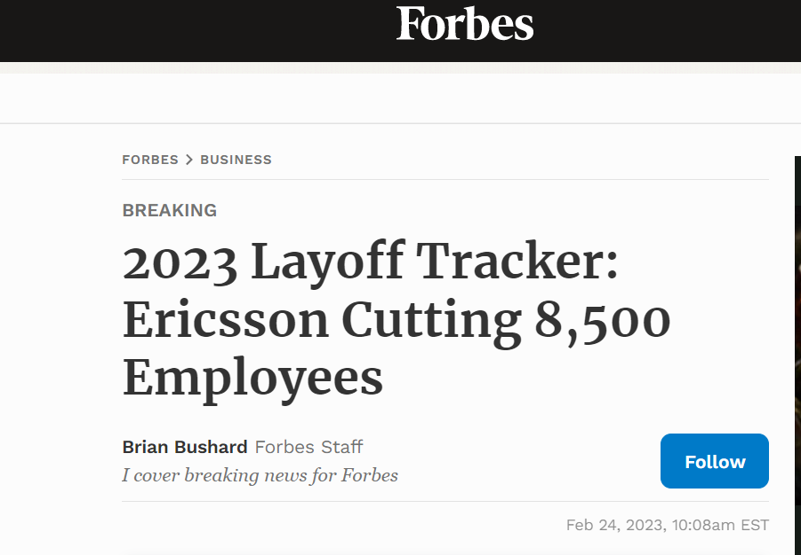
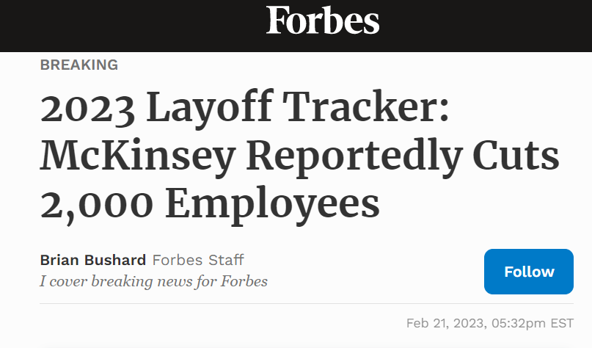
Overview of the subject
What is the current business landscape and the factors that are leading to layoffs in 2023?

Slide 4
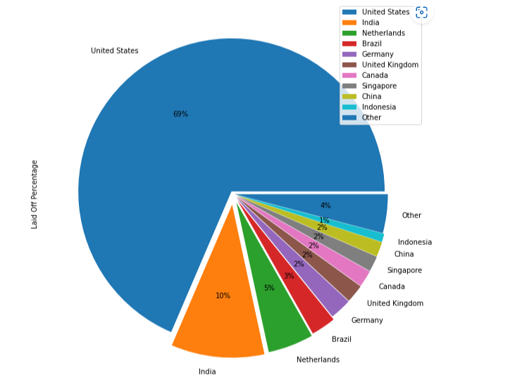
Global percentage by Country
The world largest economy shows the highest impact

Slide 5
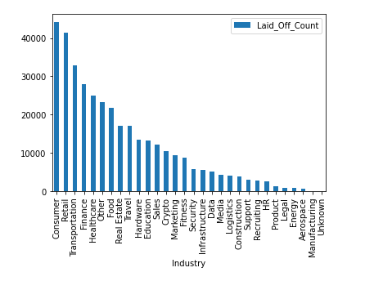
Lay off by Industry

Slide 6
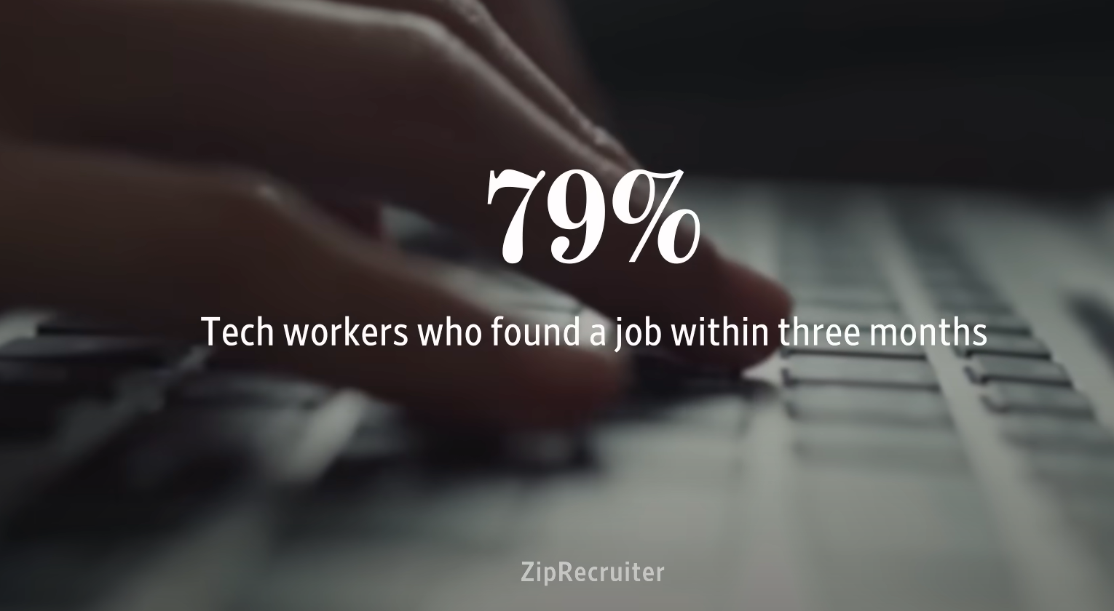
Tech industry after the layoff in 2022

